Slide 1
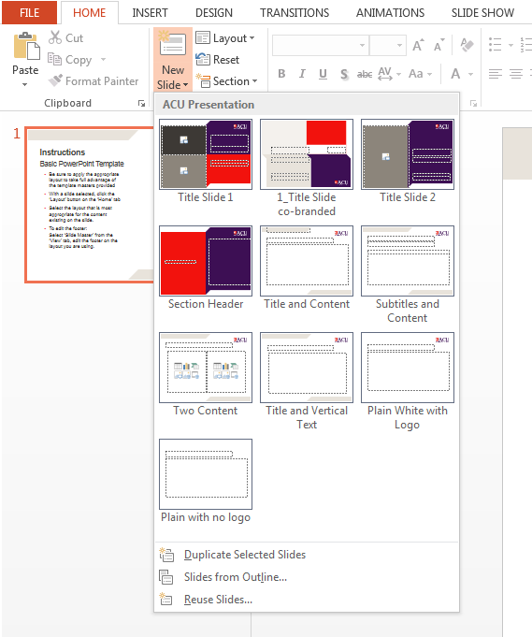
Instructions
Basic PowerPoint Template
When inserting a new slide, select the layout that is most appropriate for the content.
Create a new slide by clicking the small arrow on the ‘New Slide’ button on the ‘Home’ tab.
You can also change the layout of an existing slide: with the slide selected, click the ‘Layout’ button on the ‘Home’ tab, and select from the options.
To edit the footer: Select ‘Slide Master’ from the ‘View’ tab, edit the footer on the layout you are using.

